Slide 1
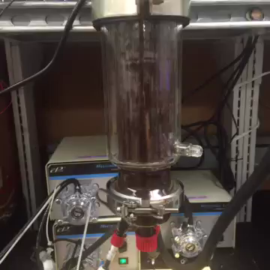
Bioreactor Data Logging
Kathryn Cogert, Alex Gilman, Alexandr Baryshev, Michael Newton

Slide 2
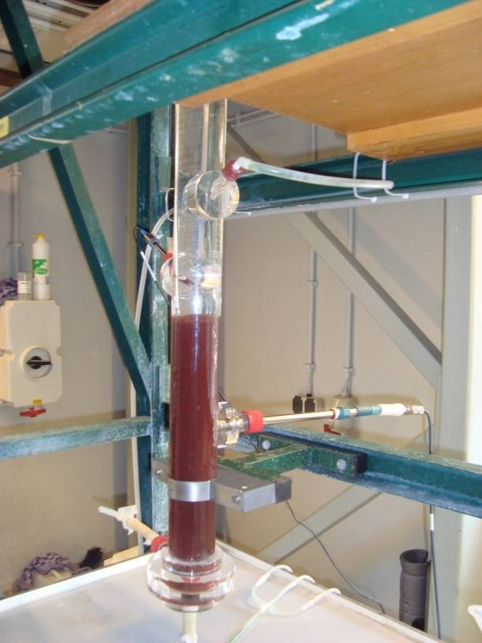
Brief Project Overview
pH
Dissolved
Oxygen
Ammonium
Concentration
Reactor Phase
Control Loop Log
How can we organize & visualize all this noise???
Notes:
BioReactors are full of data! They just need you to listen.
This bioreactor is very loud. (Not Literally)

Slide 3
Why do we need PyDrive?
Now, all the data logged is being saved locally.
We want to
Make sure data is safe
Be able to access that data from anywhere
So let’s upload to google drive!
But, how to do that programmatically…
PyDrive

Slide 4

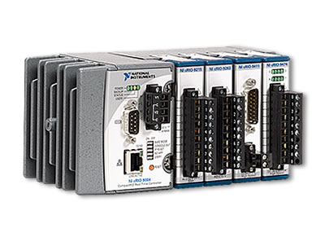

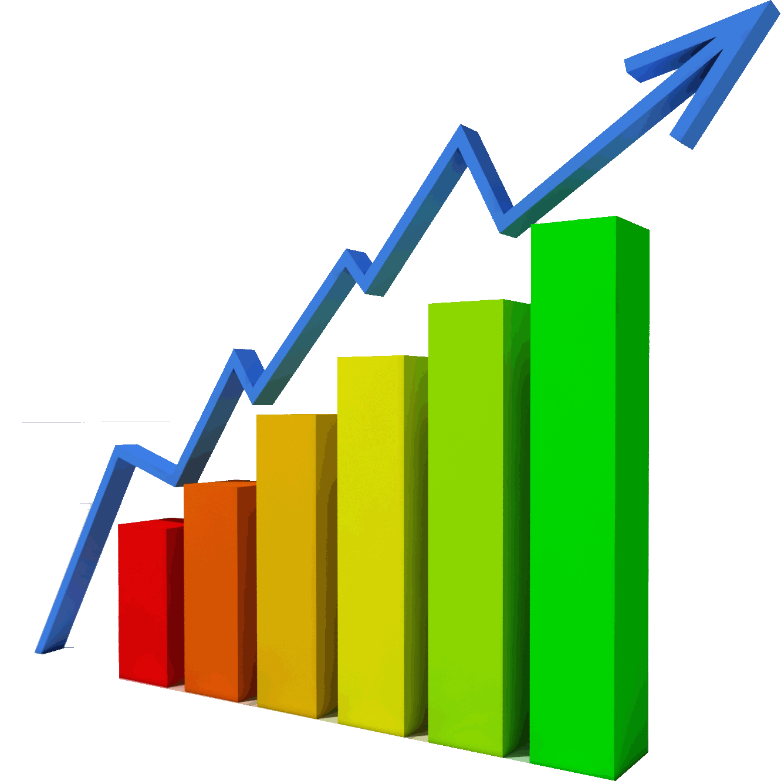
How will we use PyDrive?
Probes
in Reactor
How to do
this step?
How to do
this step?
Probe readings currently
Logged locally every second
Google Drive
Back up every
15 mins
PyDrive
Visualization

Slide 5
Bokeh – language based visualization system (instead of GUI)
Interactive visualization (panning and zooming)
Browser-based
Visualization for big-data
Driven by python
Plot “react” to live data source
“Easy” to learn but enough depth for pro-users
Hella good documentation and examples

Slide 6
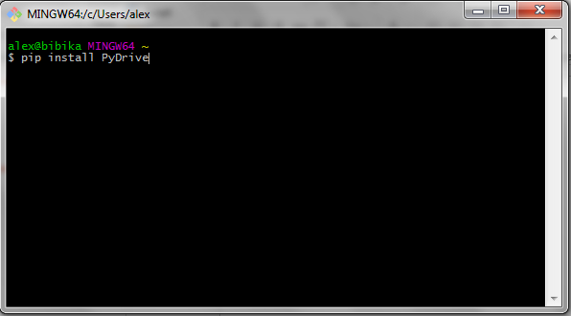
Installing PyDrive

Slide 7
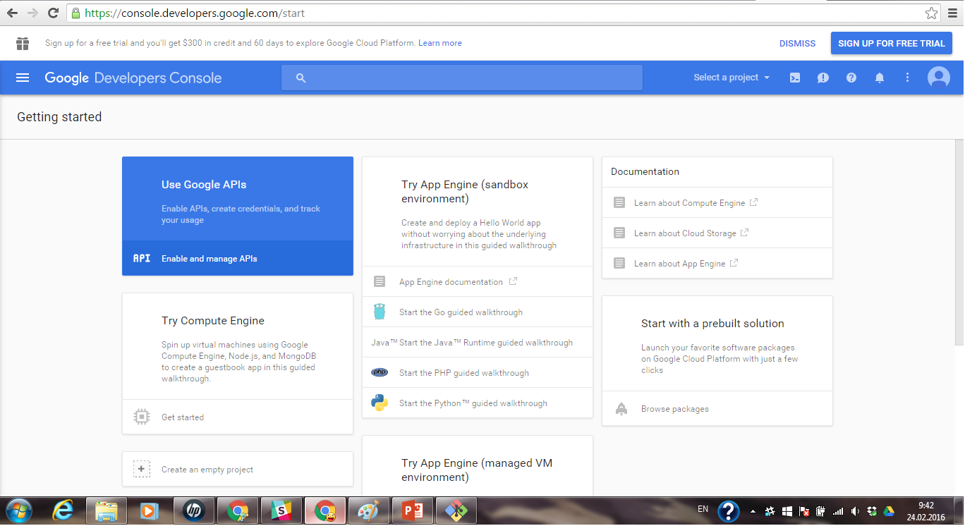
Google Developers Console

Slide 8
Google Developers Console

Slide 9
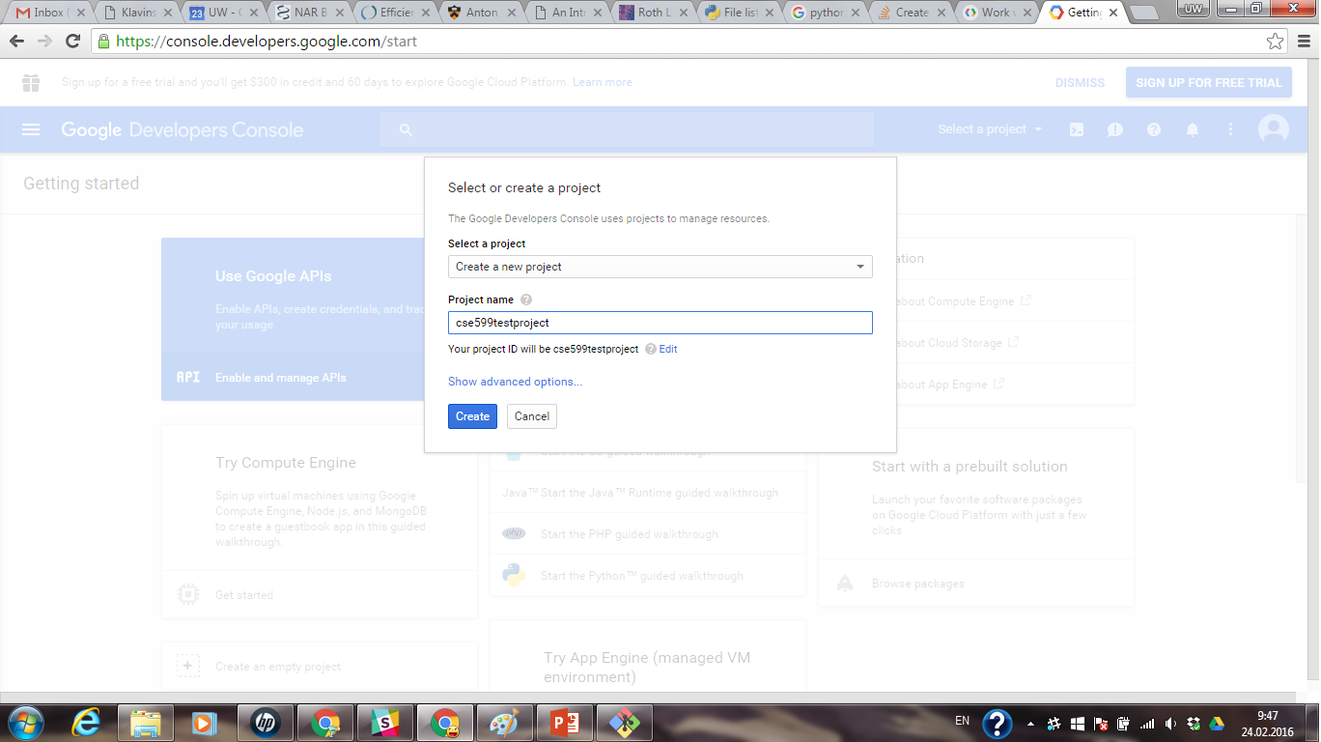
Google Developers Console

Slide 10
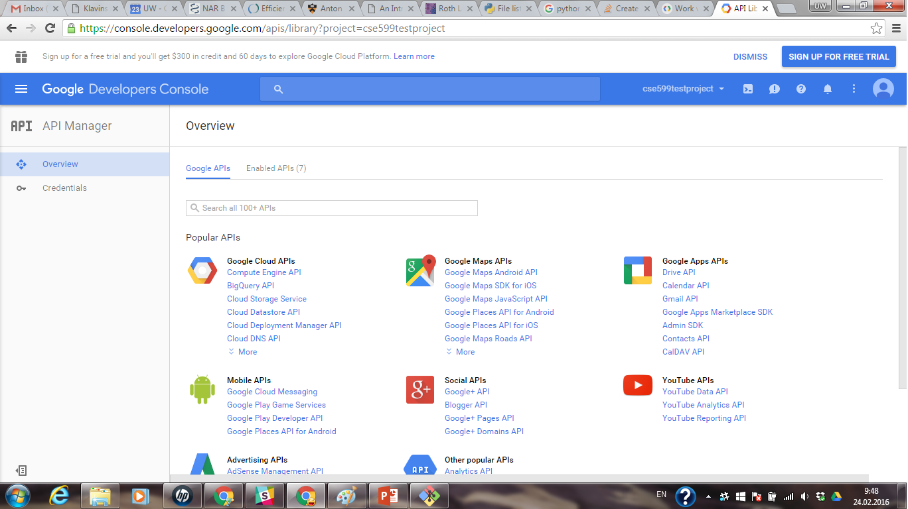
Google Developers Console

Slide 11
Google Developers Console

Slide 12
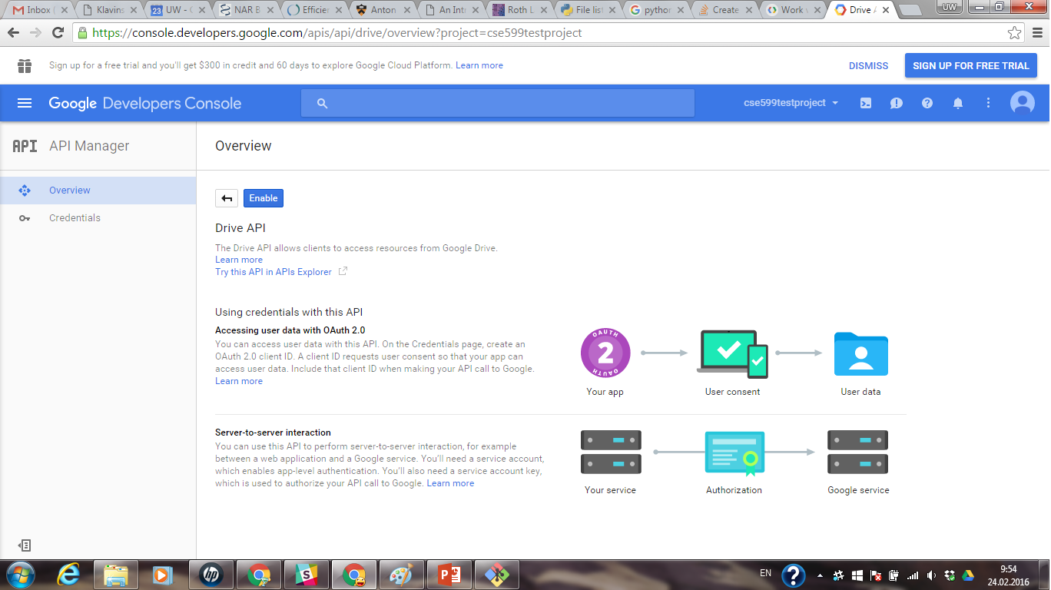
Google Developers Console

Slide 13
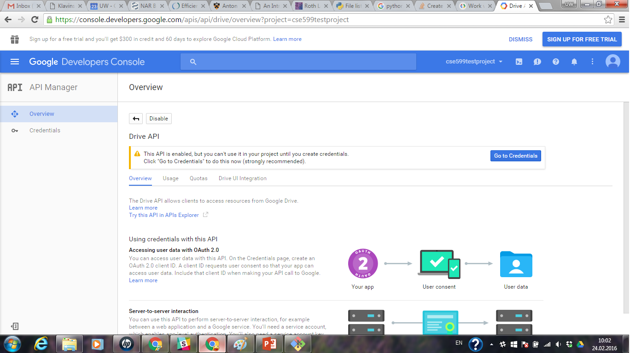
Google Developers Console

Slide 14
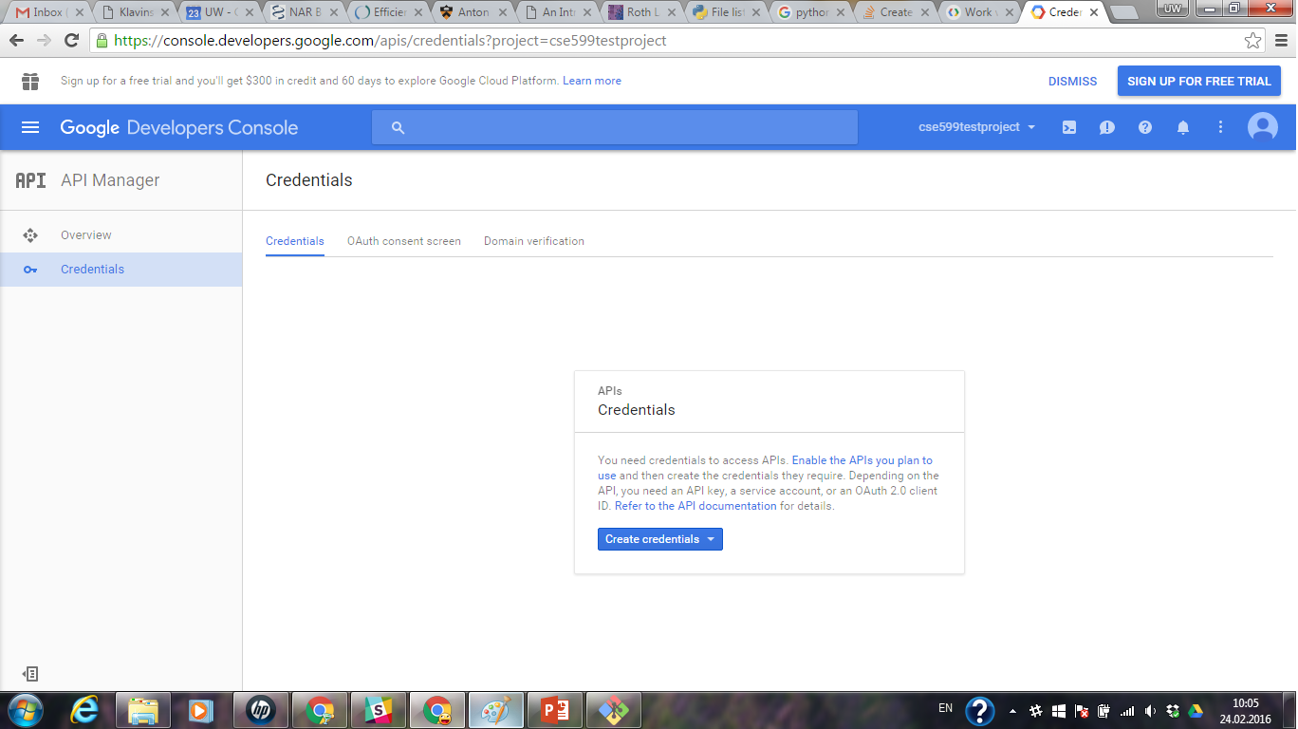
Google Developers Console

Slide 15
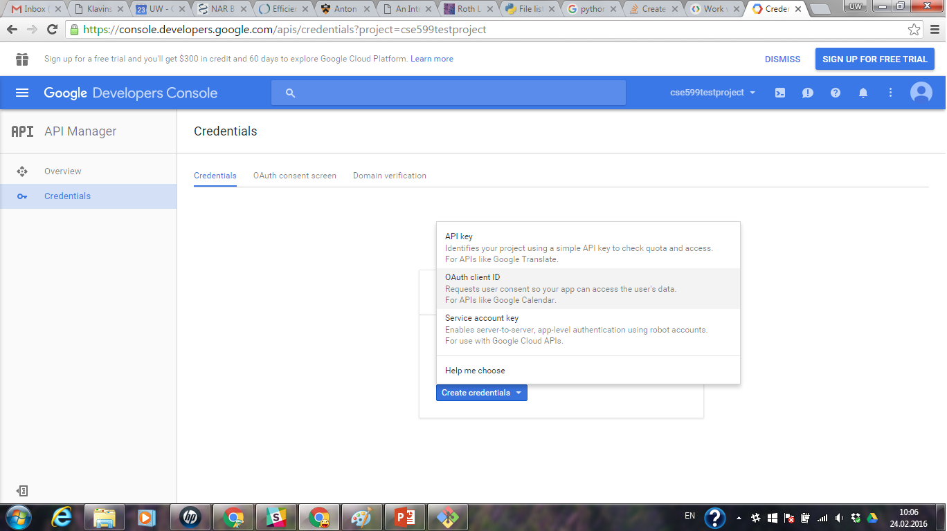
Google Developers Console

Slide 16
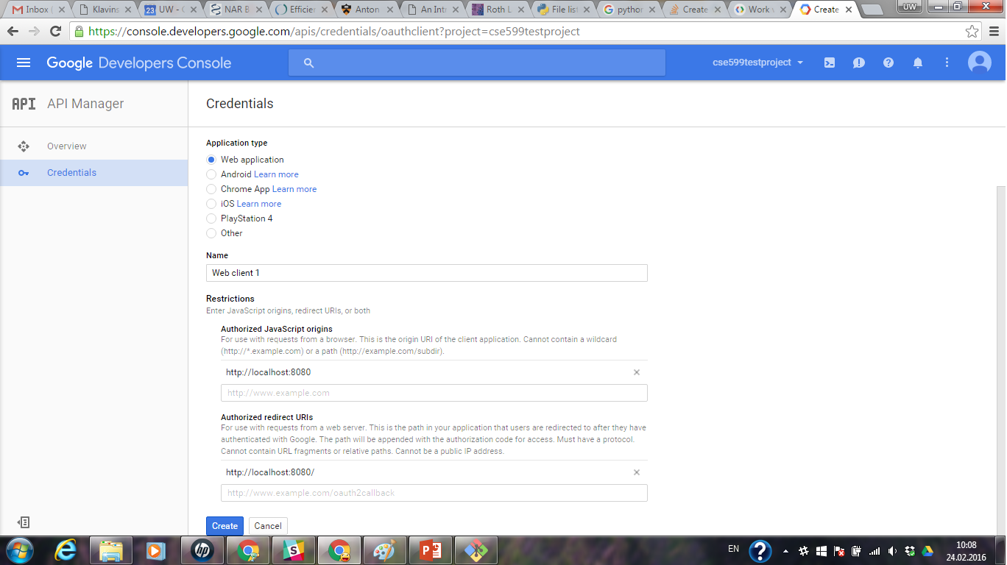
Google Developers Console

Slide 17
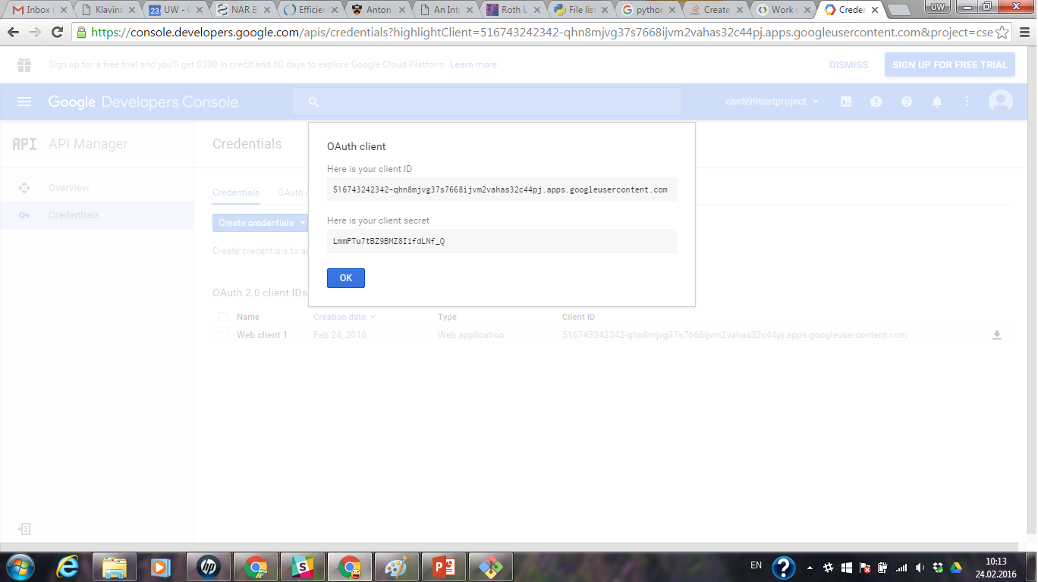
Google Developers Console

Slide 18
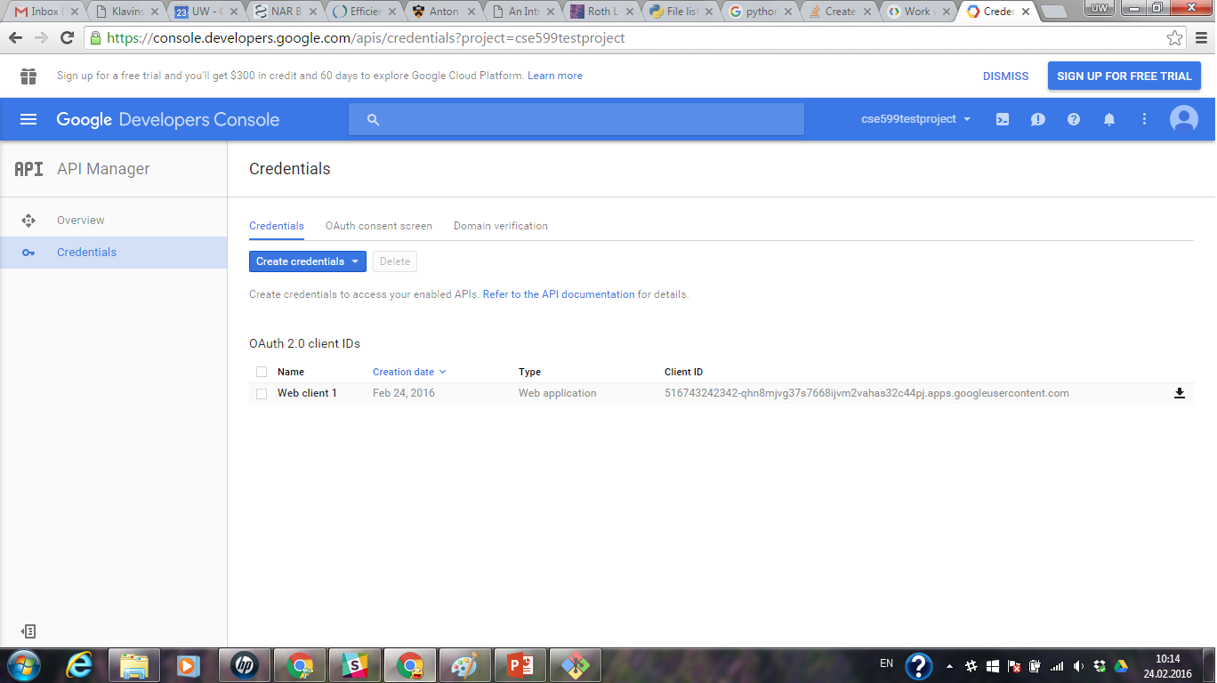
Google Developers Console

Slide 19
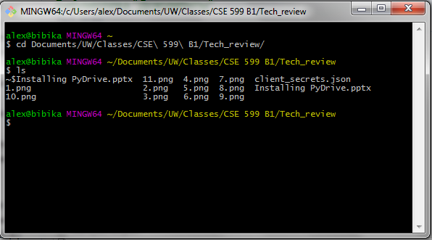
Google Developers Console

Slide 20
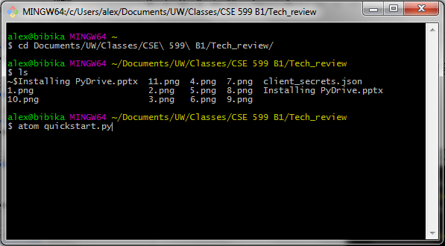
Google Developers Console

Slide 21
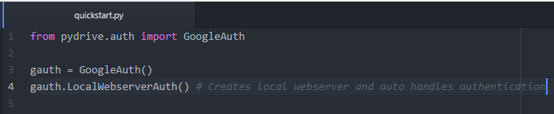
Google Developers Console

Slide 22
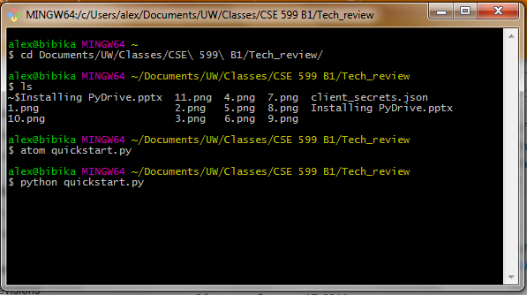
Google Developers Console

Slide 23
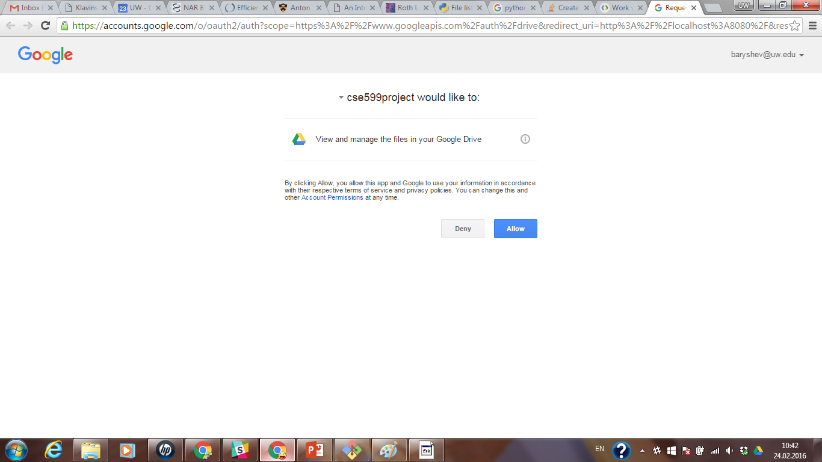
Google Developers Console

Slide 24
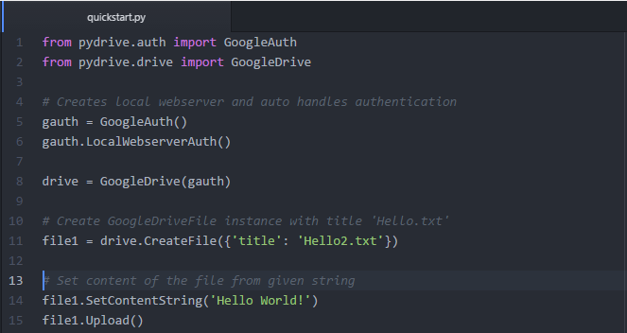
Google Developers Console

Slide 25
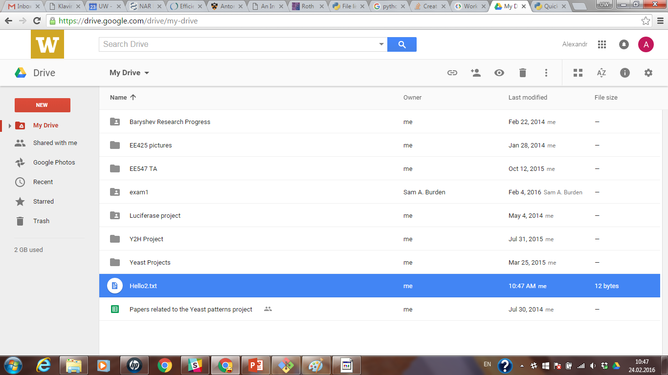
Google Developers Console

Slide 26
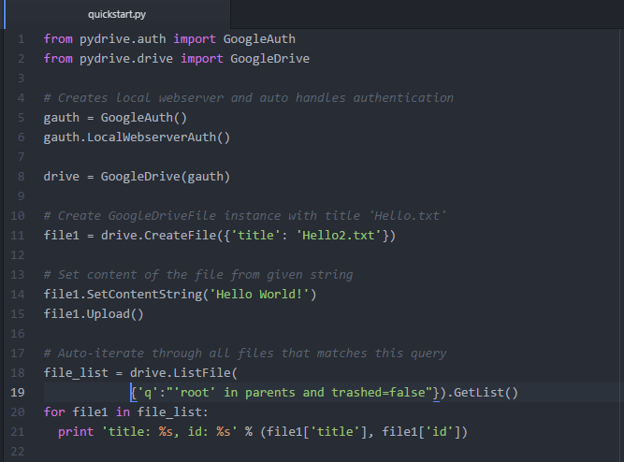
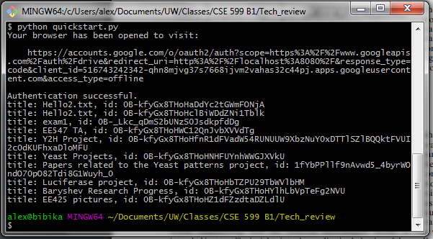
Google Developers Console

Slide 27
Google Developers Console

Slide 28
PyDrive: Advantages and Disadvantages
Advantages
Documentation has a lot of examples
It actually works!
Disadvantages
Requires python 2.7, but rest of project will be in python 3
Package has a typo, so we had to save a local copy
A lot of crawling around Stack Overflow for seemingly simple tasks
I.E. How to save in a subdirectory

Slide 29
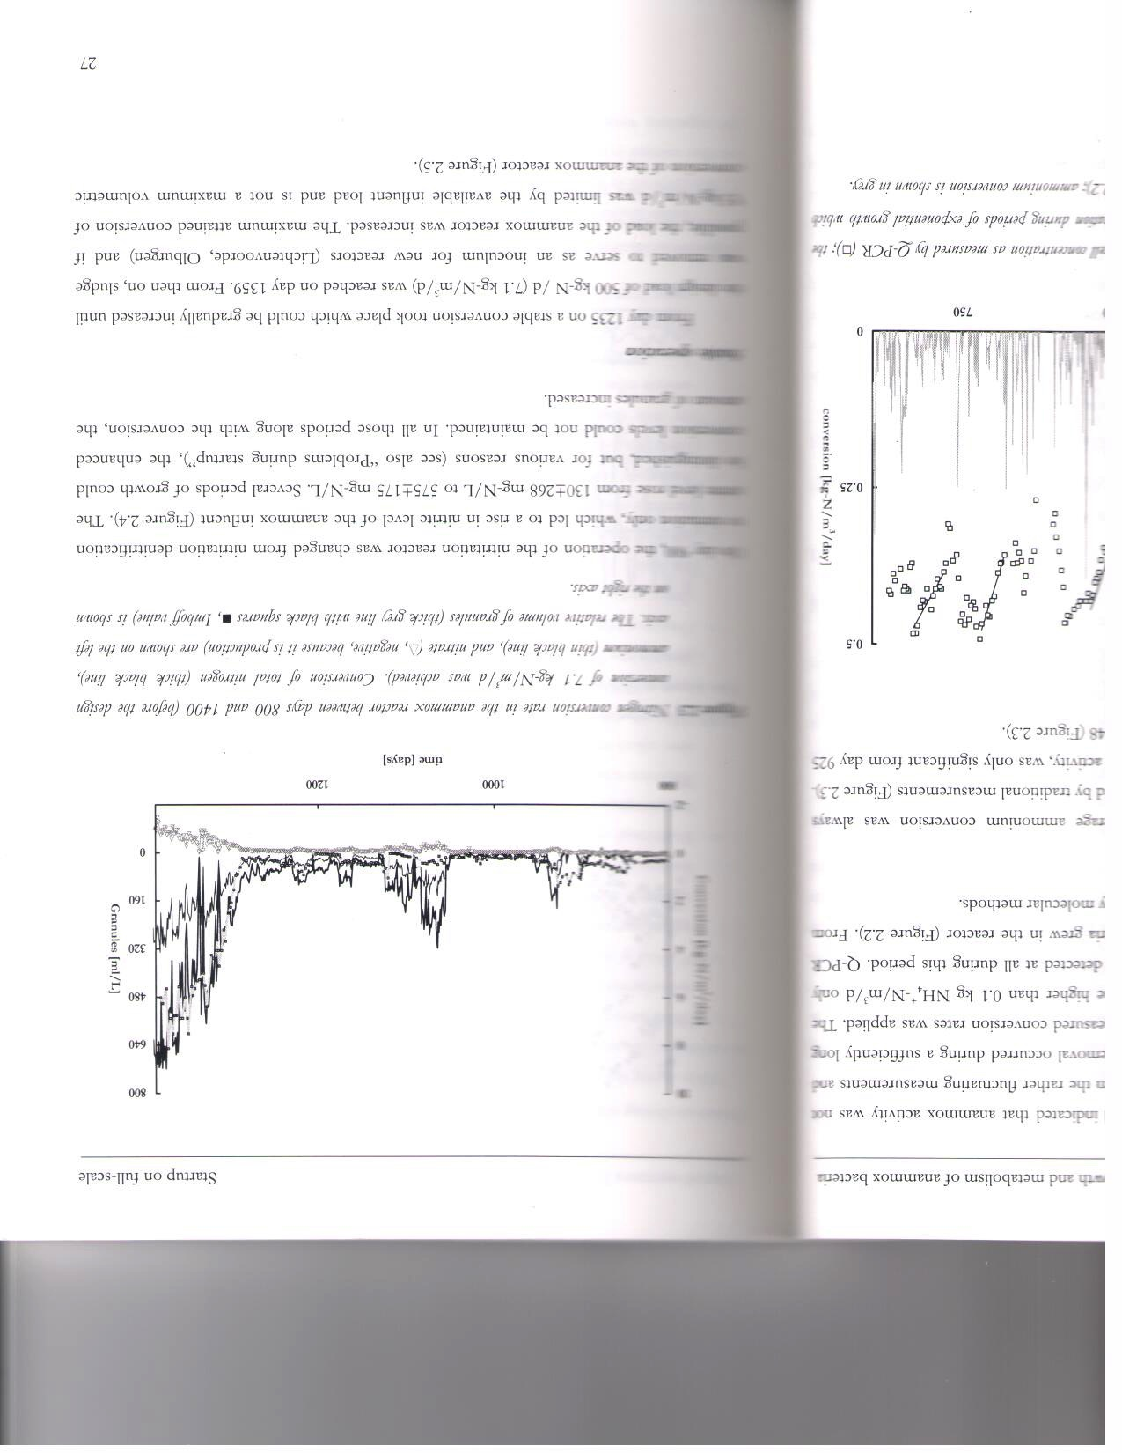
Why do we need Bokeh?
These reactors require a lot of data collection.
Data published for a similar reactor:
More than 1200 days of data!
Many data points per day!
Multiple plots!
(van der Star, 2008)
Notes:
Bokeh allows for very large and STREAMING datasets (real time)

Slide 30

How will we use Bokeh?
Bokeh
(Hat tip to the amazing brains group who tipped us off to Bokeh! Thanks guys!)

Slide 31
Bokeh
Low-level: bokeh.models
Intermediate-level: bokeh.plotting
High-level: bokeh.charts
Bokeh Server!
Widgets
Streaming Data
Notes:
Interactive visualization library for modern web browsers

Slide 32
Bokeh Server
Model Objects in Python
Model Objects in JSON
Consumed by BokehJS
Notes:
Synchronize between Python and the Browser
Use periodic,timeout, and asynchromous callbacks to drive streaming updates

Slide 33
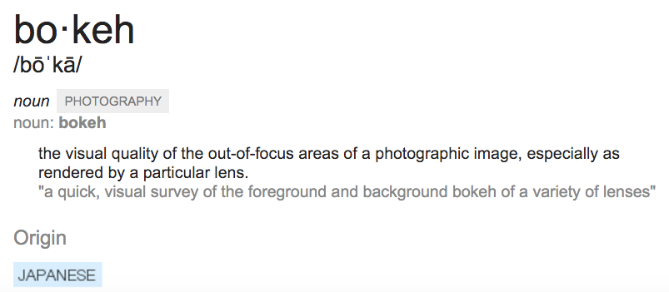


Slide 34
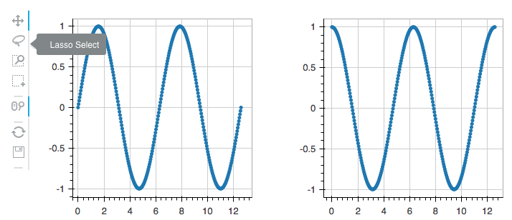
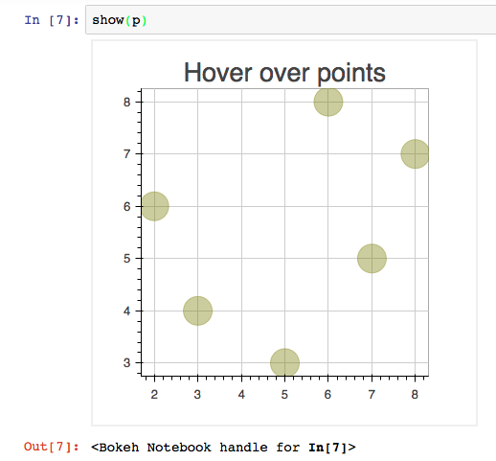
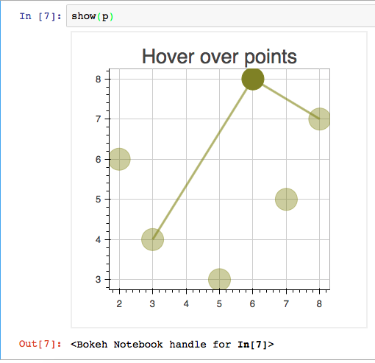
Interactive visualization

Slide 35
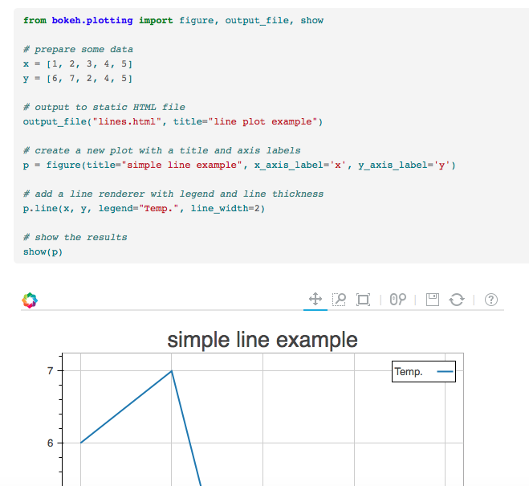
Browser-Based
Default output .html file -> new tab in browser

Slide 36
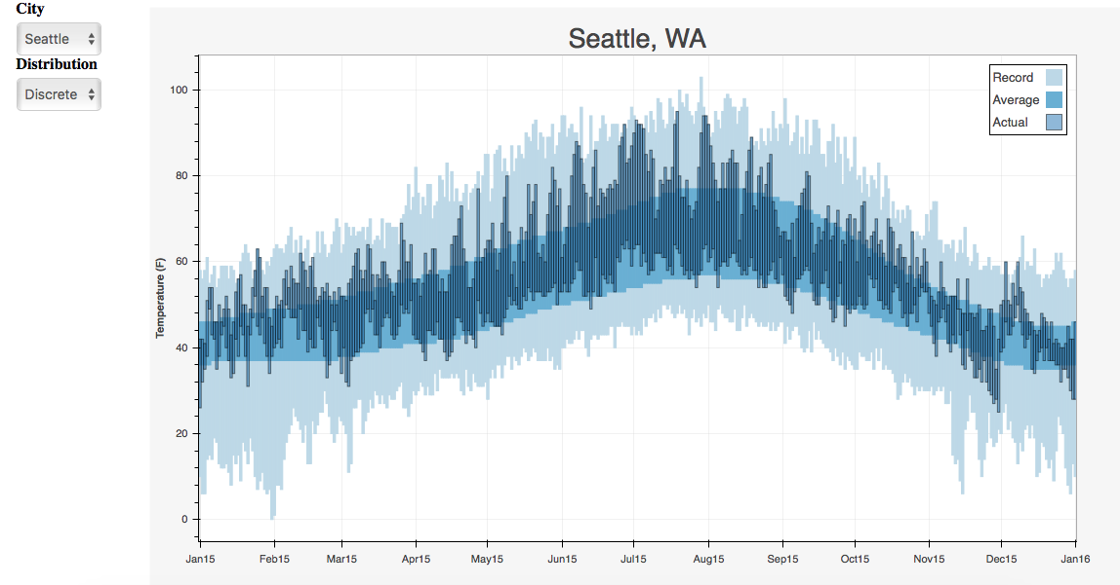
Bokeh Server

Slide 37
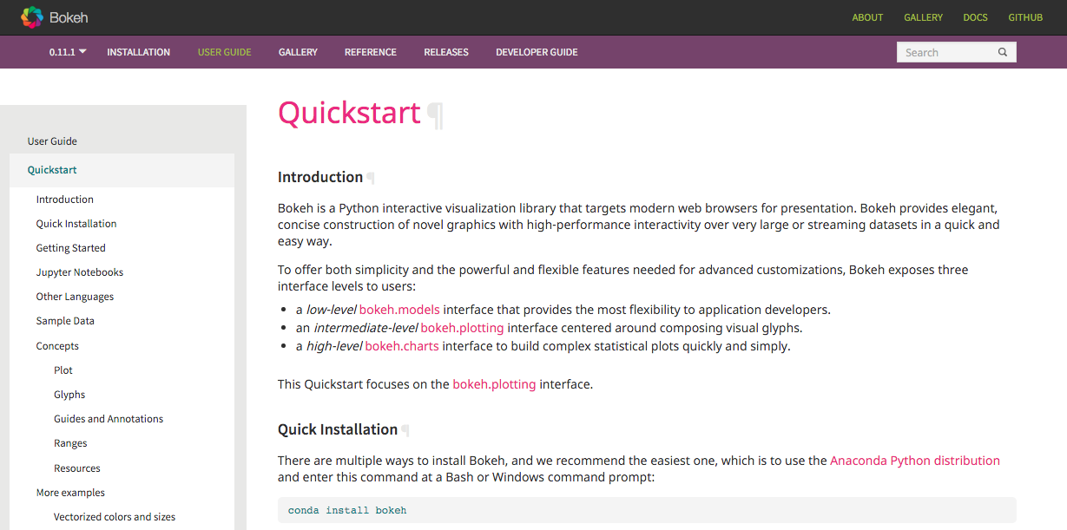
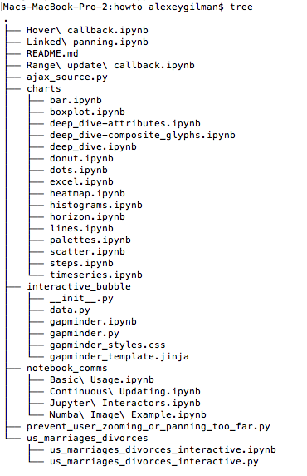
Howto directory in Bokeh repo!

